Slide 1
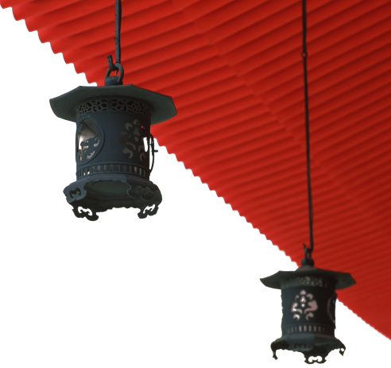
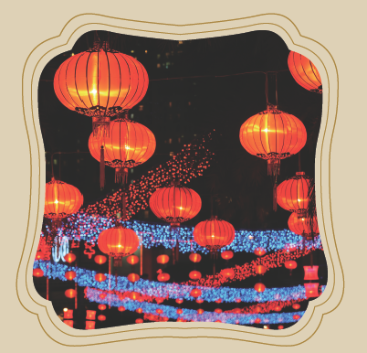
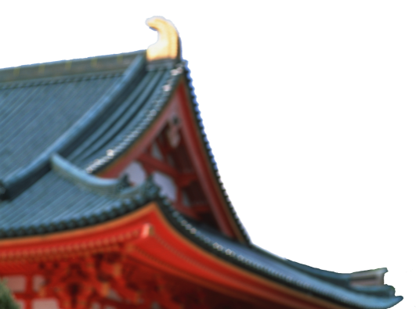
Traditional Festivals

Slide 2

学习目标
介绍中国传统节日；
了解少数民族传统节日；
思考中国传统节日的传承和保护。

Slide 3
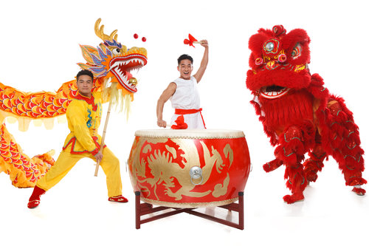
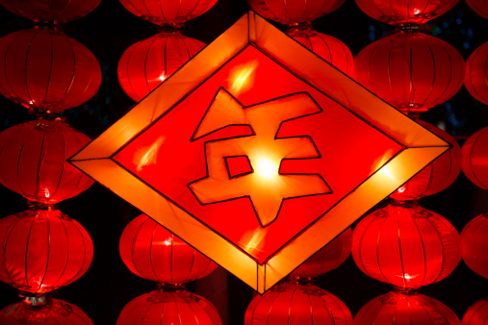
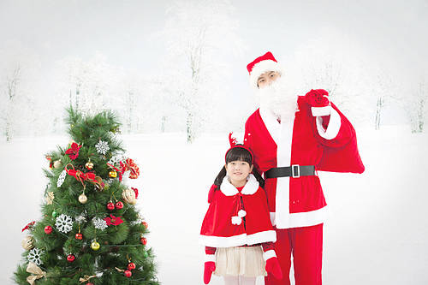
1
2
Overview
3
Lead-in Activity
Chinese Festivals
Discussion &
Presentation

Slide 4
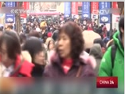

Lead-in Activity
Discuss
Watch the video and discuss the following questions:
1 What’s the new trend of spending holidays for Chinese
people?
2 How do overseas retailers cater to Chinese shoppers?

Slide 5
1
2
Overview
3
Lead-in Activity
Chinese Festivals
Discussion &
Presentation

Slide 6
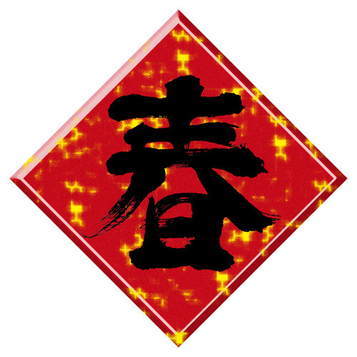
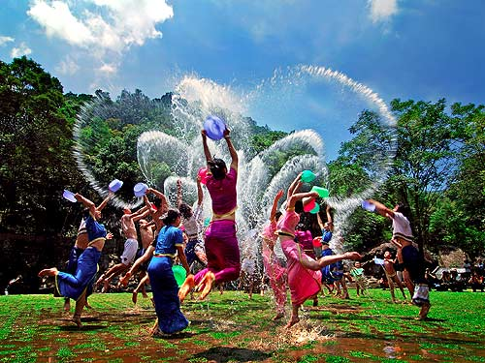
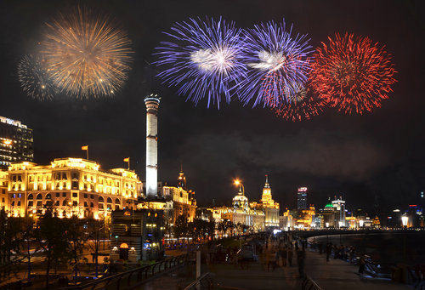
Chinese Festivals
1
2
3
Major Traditional Festivals
Ethnic Minority Festivals
Public Holidays and Traditional Festivals

Slide 7
Major Traditional Festivals
Spring Festival
Lantern Festival
Qingming Festival
Dragon Boat Festival
Double Seventh Festival
Mid-Autumn Festival
Double Ninth Festival

Slide 8
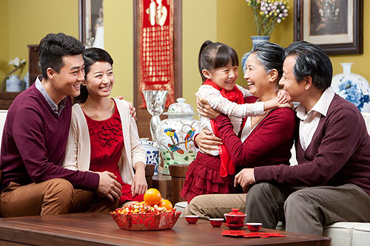
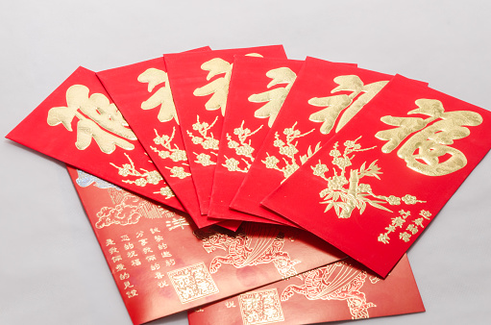
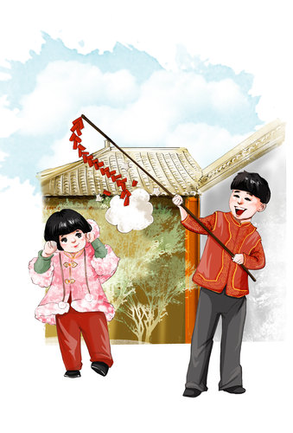
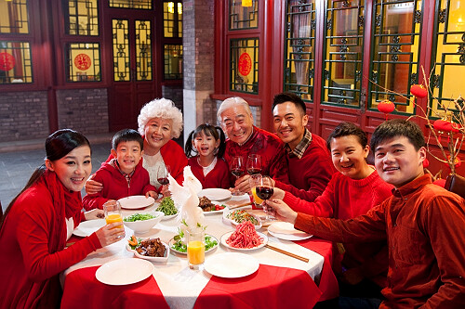
Spring Festival
What will occur to your mind when you think of Spring festival?
family get-together
lucky money
fire crackers
family reunion dinner

Slide 9
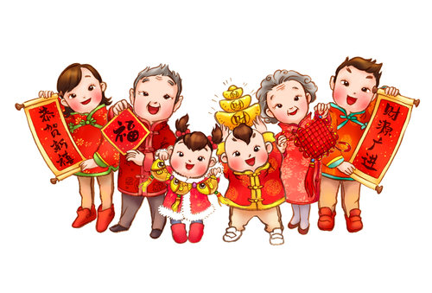
Spring Festival
Spring Festival
also called the Chinese New Year
falls on the first day of the first lunar month
family members gather together just as westerns do on Christmas
with seven days of holiday

Slide 10
Spring Festival
The legend of spring festival
Use the clues to tell the story，please write down the story.
Nian
firecrackers
ferocious
New Year’s eve
devour animals and people
flame
red color
villagers
scare off the monster
flee to the mountains
first day of the first lunar month
grandma
beggar

Slide 11
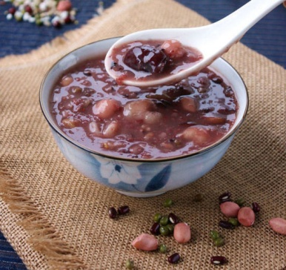
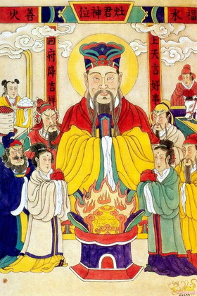
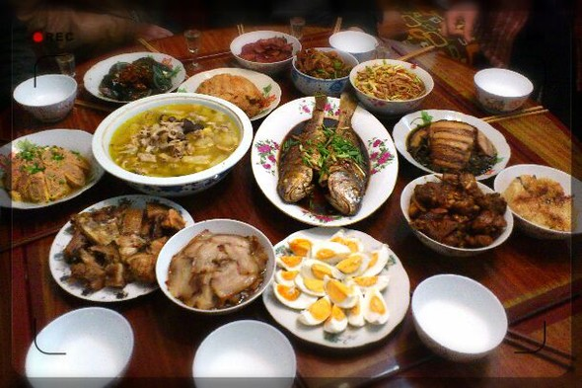
Spring Festival
On the 8th day of the 12th lunar month, laba porridge was made. It contains all kinds of beans.
On the 23rd day of the 12th lunar month, sacrifices are offered to the Kitchen God. Now, people make delicious food to enjoy themselves.
decorations are prepared before Spring Festival
a sumptuous family dinner is served on the Spring Festival eve

Slide 12
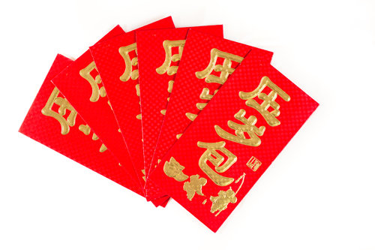
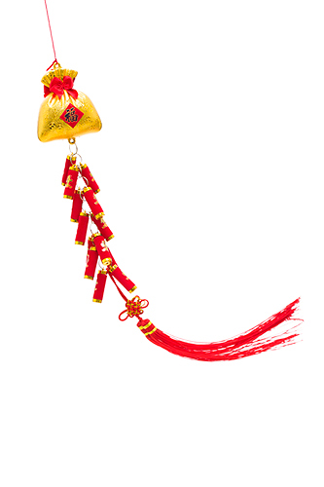
Spring Festival
Spring festival gala watched by millions of Chinese after dinner on New Year’s Eve
On New Year’s Day, everybody dresses up
lucky money was given to the children
firecrackers were burned

Slide 13
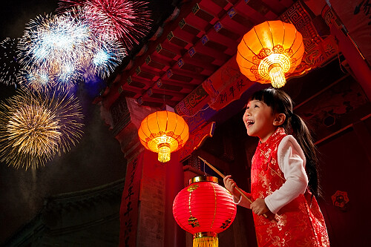
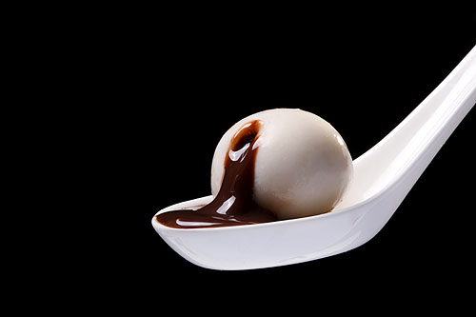
Lantern Festival
celebrated on the 15th day of the first lunar month
with a grand display of beautiful lanterns
riddles pasted onto lanterns are guessed
yuanxiao, a kind of rice dumplings, was eaten

Slide 14
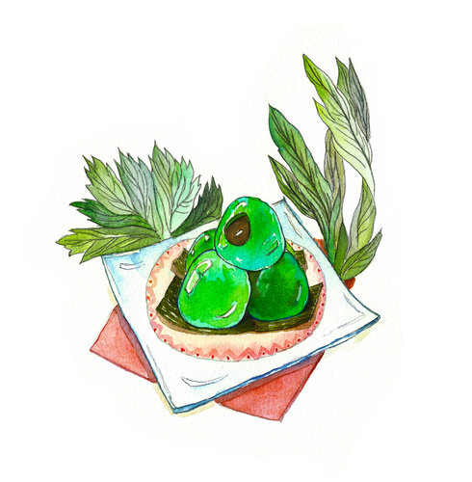
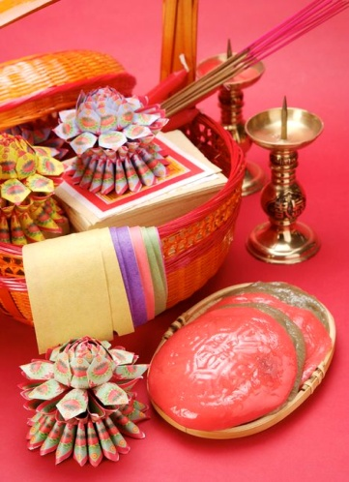
Qingming Festival
a day for mourning the dead
falls on 4---6 April each year
after the festival, the temperature rises and rainfall increases
in readiness for spring plowing

Slide 15
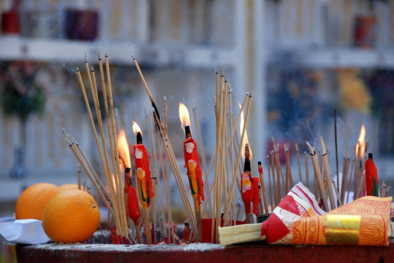
Qingming Festival
originates from the legend of Jie Zitui
tomb sweeping is an important activity
cold food was prepared the day before
kite flying and playing on the swing were also activities during the festival

Slide 16
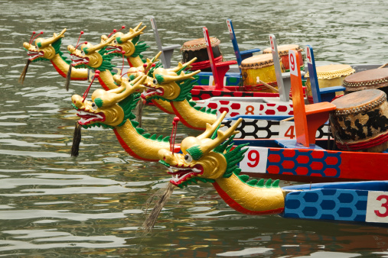
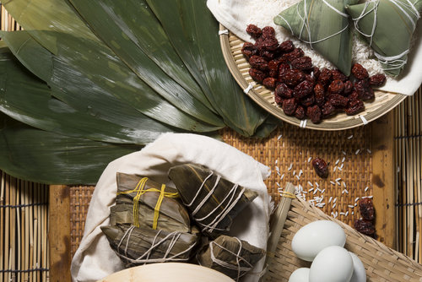
Dragon Boat Festival
also called Duanwu Festival
originates from Qu Yuan
zongzi was eaten
dragon boat racing being an indispensable part

Slide 17
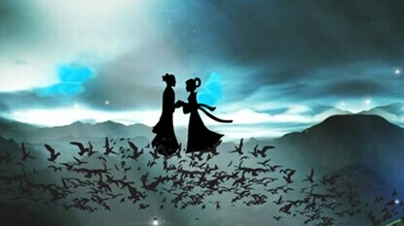
Double Seventh Festival
Chinese Valentine’s Day
originates from the story of Niu Lang and Zhi Nv

Slide 18
Mid-Autumn Festival
Some famous lines about the festival:
I raised my head, the splendid moon I see; Then droop my head and sink to dreams of my hometown.
(举头望明月， 低头思故乡)
My one wish for you, then , is long life; And a share in this loveliness(the moon) far, far away.
(但愿人长久， 千里共婵娟)

Slide 19
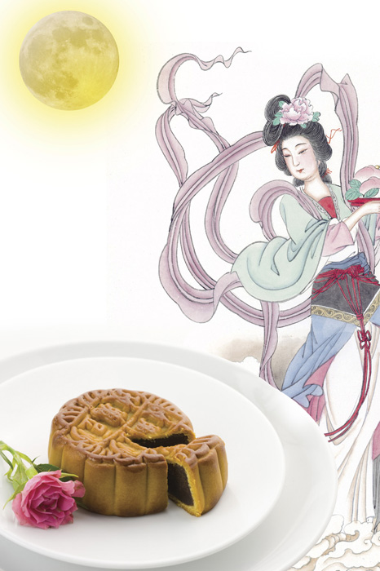
Mid-Autumn Festival
Please tell the legend about the festival

Slide 20
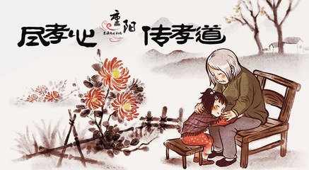
Double Ninth Festival
celebrated on the ninth day of the ninth lunar month
began as early as the Warring States period
activities include: outing and enjoying the scenes, climbing mountains, appreciating chrysanthemum, wearing dogwood, eating Chongyang pastry and drinking chrysanthemum wine
the Chinese government designated the festival as “Senior Citizens Day” in 1989

Slide 21
Chinese Festivals
1
2
3
Major Traditional Festivals
Ethnic Minority Festivals
Public Holidays and Traditional Festivals

Slide 22
Ethnic Minority Festivals
Water-splashing Festival
Nadam Fair
Torch Festival
Danu Festival
Third Month Fair
Antiphonal Singing Day
Tibetan New Year
Jumping Flower Festival

Slide 23
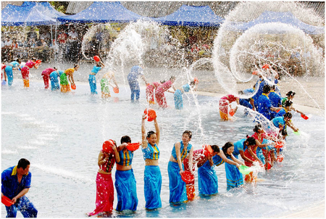
Water-Splashing Festival
Dai people’s New Year
usually lasts three or four days
1st day: rocket launching, dragon boat rowing, etc
2nd day: Neuter Day, when people stay at home or go hunting
3rd day: pray in the temples and water splashing begins

Slide 24
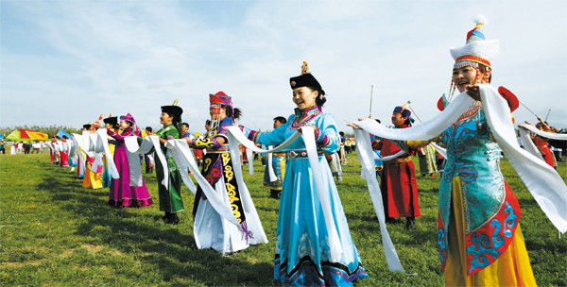
Nadam Fair
observed by the Mongolian people
celebrated in August
main events include: horse racing, wrestling, archery and theatrical performances

Slide 25
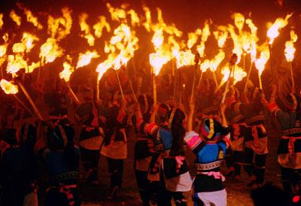
Torch Festival
traditional festival of the Yi people and some other ethnic minority groups in southwest China
big, pagoda-shaped pine torches were built
people holding the torches gather together to sing, dance and drink, in hope of having a good harvest next year

Slide 26
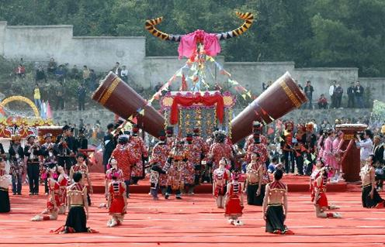
Danu Festival
Yao’s New year
lasts four days from the 26th of the fifth lunar month
activities include: dancing the bronze drum dance, doing antiphonal singing, and joking in drinking

Slide 27
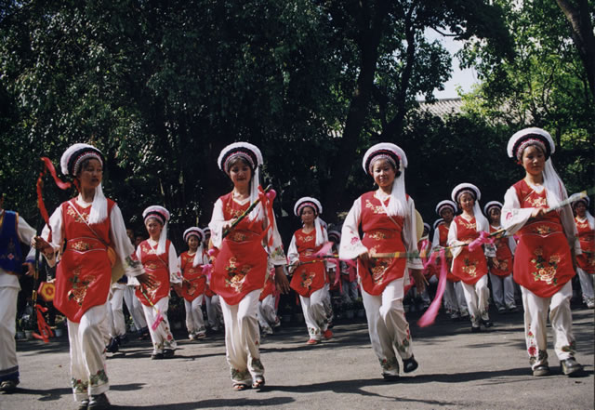
Third Month Fair
festival of the Bai people
lasts from 15th to the 21st of the third lunar month
activities include horse racing, archery, singing, dancing and a commodity fair
also an occasion for love

Slide 28
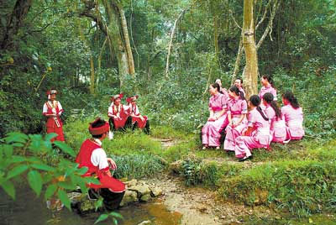
Antiphonal Singing Day
a traditional festival for the Zhuang people and some other ethnic minorities
young people, dressed in their best, gather in the fields and do antiphonal singing in groups with those of the opposite sex

Slide 29
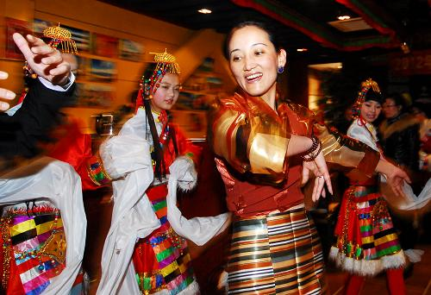
Tibetan New Year
most important festival in Tibet
lasts 15 days from 1 January to 15 January
mass singing and dancing, as well as traditional Tibetan operas are performed in towns and villages

Slide 30
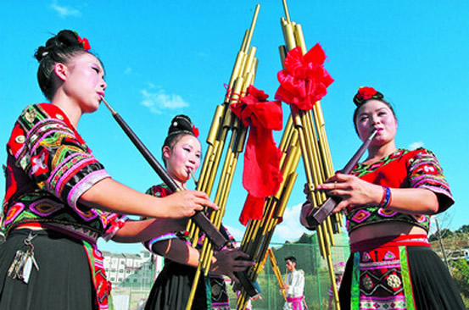
Jumping Flower Festival
celebrated by the Miao people in Yunnan and elsewhere
activities include: singing, lusheng dancing, bull fighting, lion dancing and a flower-pole-climbing contest

Slide 31
Chinese Festivals
1
2
3
Major Traditional Festivals
Ethnic Minority Festivals
Public Holidays and Traditional Festivals

Slide 32
Public Holidays and Traditional Festivals
In China, people enjoy about 115 days off every year,
including 104 days of weekends and 11 days of festivals
China has seven legal holidays
if the holiday lands on a weekend, the days will be reimbursed (补偿）after the weekend
holidays have become peak seasons for travel and tourism

Slide 33
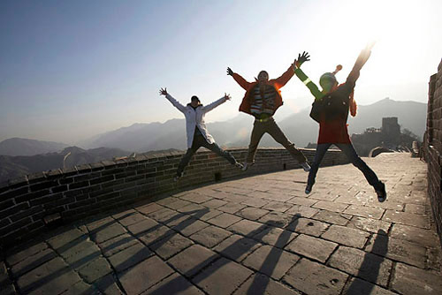
Public Holidays and Traditional Festivals
What do you usually do on public holidays?
Do you prefer to travel or to enjoy yourself at home on public holidays?

Slide 34
1
2
Overview
3
Lead-in Activity
Chinese Festivals
Discussion &
Presentation

Slide 35
Discussion
In December 2006, 10 doctoral candidates of China’s top universities presented a petition (请愿书) on the Internet which calls for people to be less excited about Western holidays and to attach more importance to traditional Chinese festivals. The petition caused fierce discussion on whether Chinese people should celebrate Western festivals. Please discuss with your partner and then share your opinions with the class.

Slide 36
Students’ Presentation
The Valentine’s Day in Western countries is a festival of romance and many people give cards, letters, flowers or presents to their spouse or partner. In China, on the seventh day of the seventh lunar month, people celebrate the Double Seventh Festival which is a traditional festival known by young people as China’s Valentine’s Day. You have a foreign friend who shows great interest in the origin of China’s Valentine’s Day and how people celebrate it. Try to gather as much information as possible about this traditional event and explain the details to him.

Slide 37
Students’ Presentation
Information about Chinese Valentine’s Day
Chinese Valentine's Day is on the 7th day of the 7th lunar month in the
Chinese calendar.
also called qixi
Orgin: A love story for this day is about the 7th daughter of Emperor of
Heaven and an orphaned cowherd. The Emperor separated them. The
7th daughter was forced to move to the star Vega and the cowherd
moved to the star Altair. They are allowed to meet only once a year on
the day of 7th day of 7th lunar month.
gifts like flowers and chocolate are given on this holiday

Slide 38

The End

